Slide 1
Literacy from Scratch at Key Stage 1
Lawrence Williams
Brunel University, MirandaNet, and
World Ecitizens, London, UK
Notes:
Logos - Brunel: Partnership School Project, with Swaminarayan School ; MirandaNet: Presentation at BETT ; World Ecitizens: Start of new developments in World Ecitizens

Slide 2
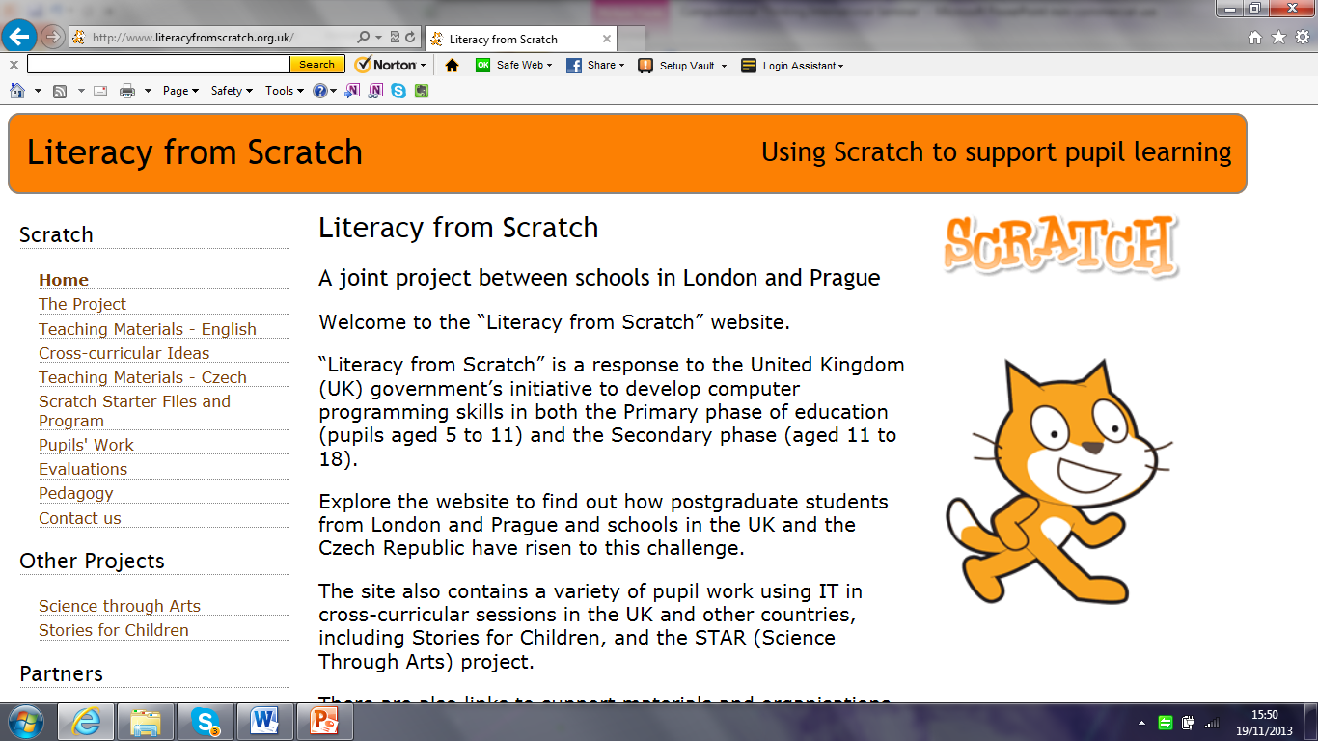
Literacy from Scratch www.literacyfromscratch.org.uk
Notes:
The website which will soon house the work of the Swaminarayan School.

Slide 3
Brunel University Partnership School
Working with Years 1 and 2
Notes:
Lawrence Williams, Brunel University, worked with Donna and Francis, Year 1 and Year 2 teachers at the school, with the active support of the Head Teacher, Mr. Raja.

Slide 4
Key stage 1: ages 5 and 6
Pupils should be taught to:
understand what algorithms are, how they are implemented as programs on digital devices, and that programs execute by following precise and unambiguous instructions
create and debug simple programs
use logical reasoning to predict the behaviour of simple programs (Computing)
use technology purposefully to create, organise, store, manipulate and retrieve digital content (ICT)
recognise common uses of information technology beyond school
use technology safely and respectfully, keeping personal information private; identify where to go for help and support when they have concerns about content or contact on the internet or other online technologies (Digital Literacy)
Notes:
The Key Stage 1 Programme of Study for Computing in England and Wales.

Slide 5
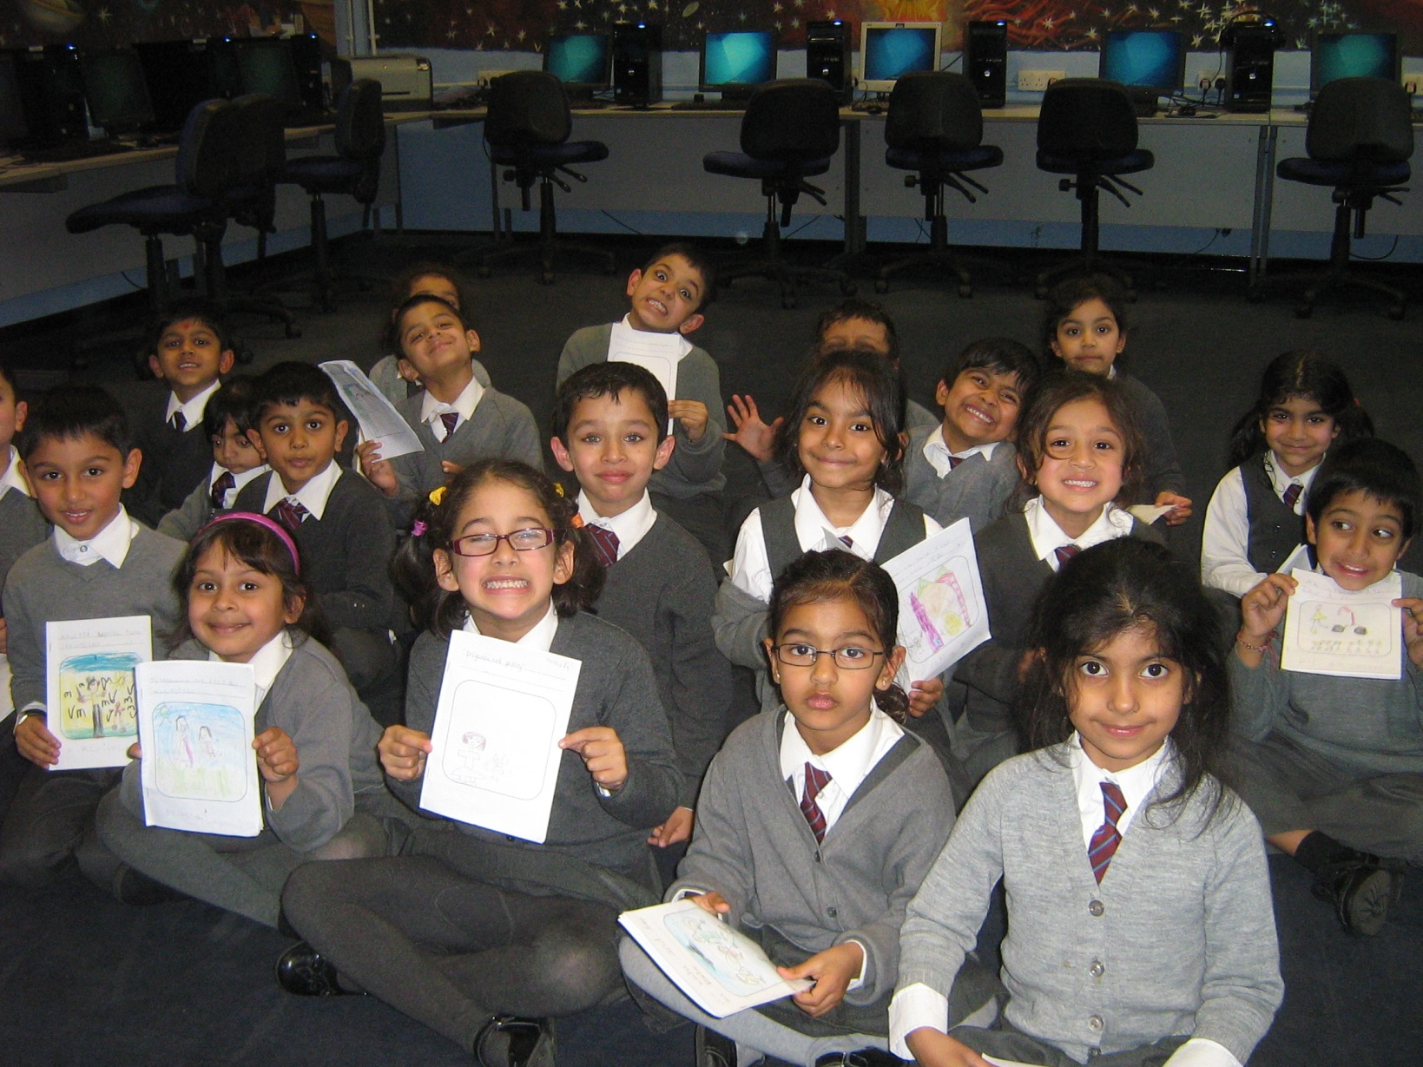
Year 1 pupils aged 5 years
Notes:
Original stories, about a lost toy.

Slide 6
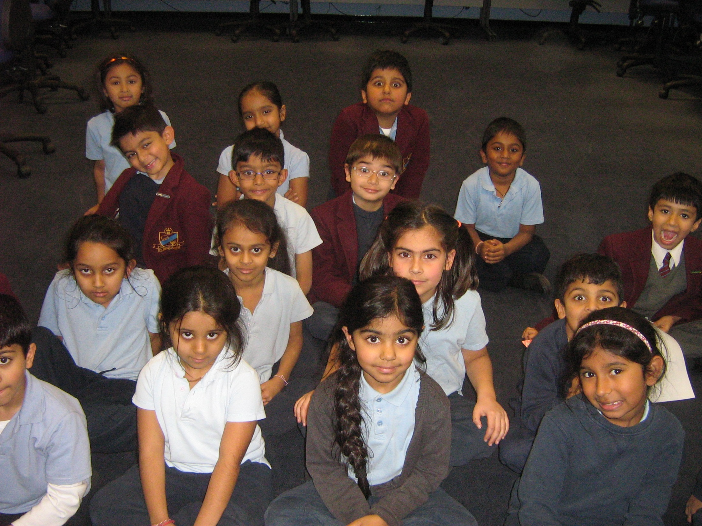
Year 2 pupils aged 6 years
Notes:
Mr. Naera’s class.

Slide 7
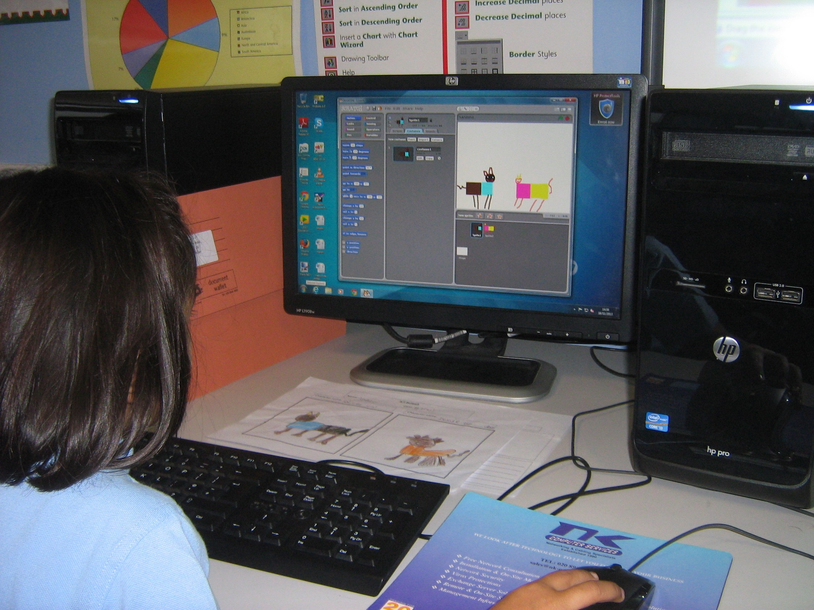
Creating Sprites, in Scratch
Notes:
This picture captures much of the learning process: Story folder on left. Hand drawn Sprites on the table. Scratch editor, in which the draft pictures are digitally created.

Slide 8
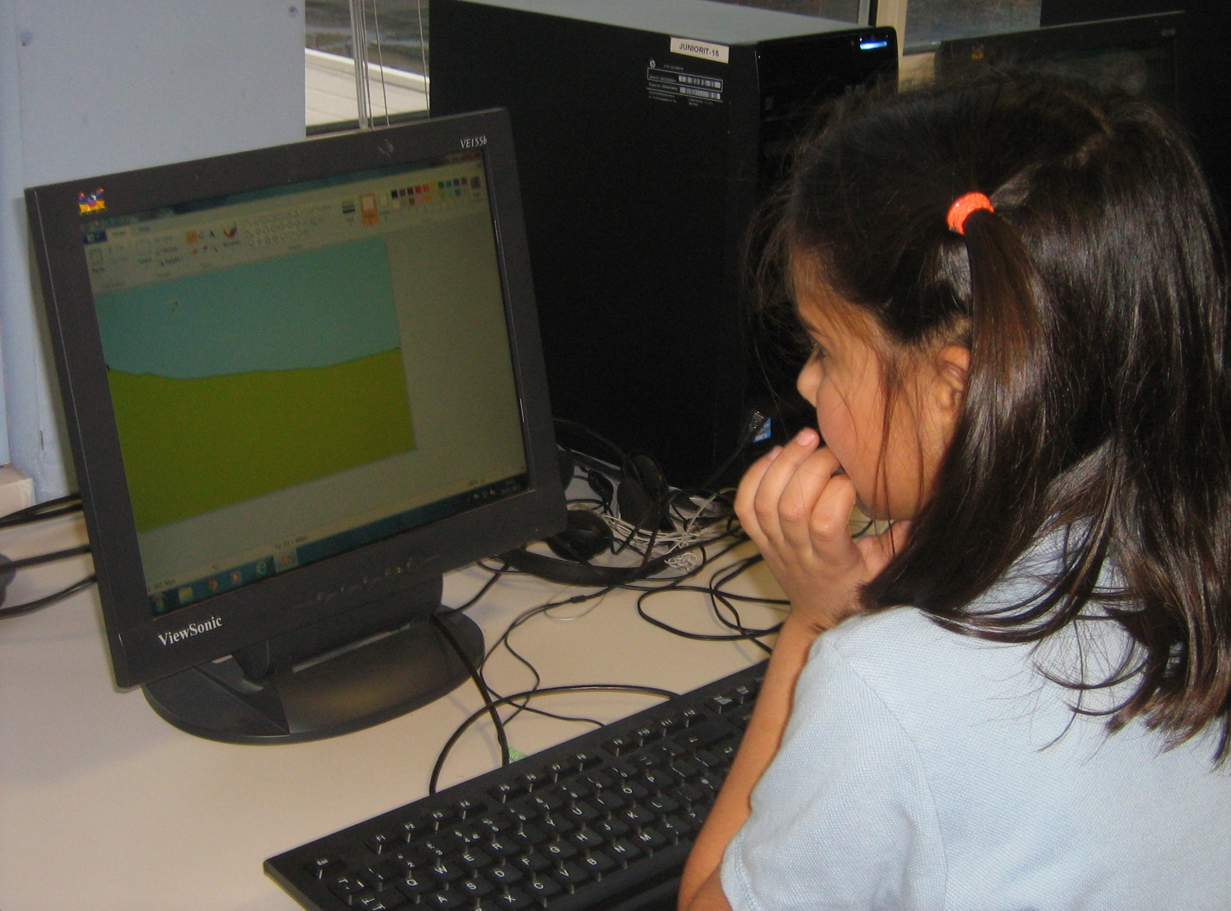
Creating Backgrounds, in Paint
Notes:
One of three simple Backgrounds. These Backgrounds need to be kept simple, in order for the Sprites to be more easily visible.

Slide 9
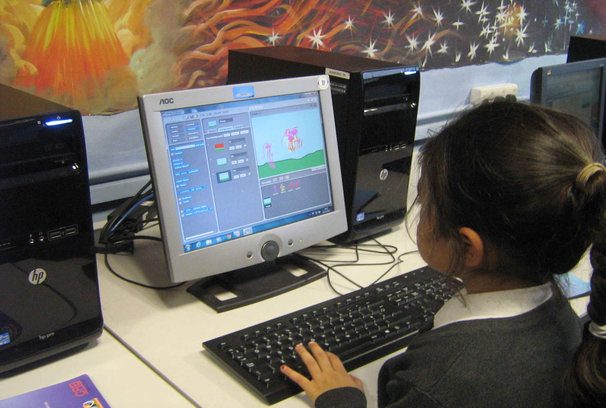
Integrating Paint and Scratch files
Notes:
Original Sprites are added to the independently produced Backgrounds, in preparation for the story to unfold.

Slide 10
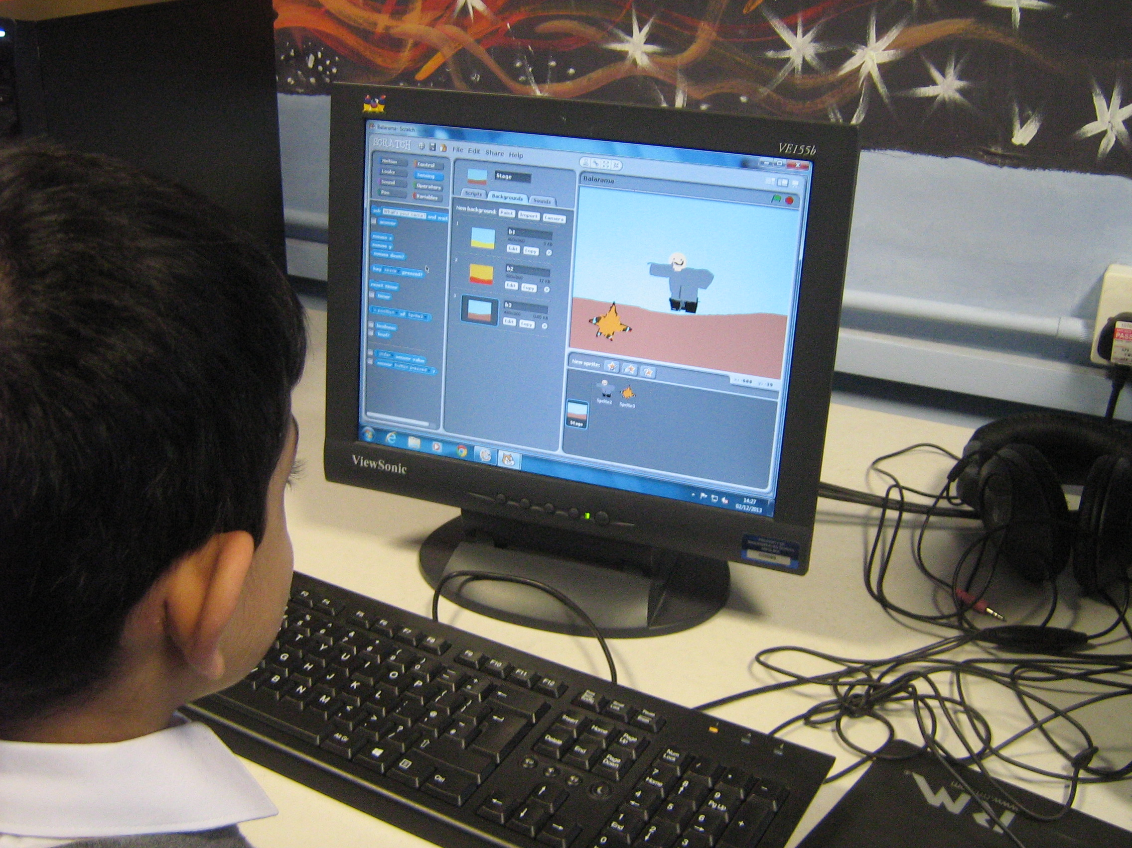
Notes:
As the previous slide.

Slide 11
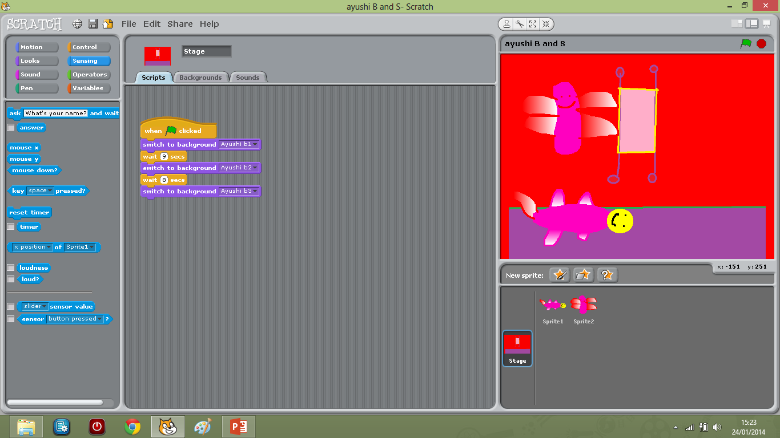
Moving between scenes
Notes:
Backgrounds need to be changed, and timed. This image will be replaced by a pupil’s own work….

Slide 12
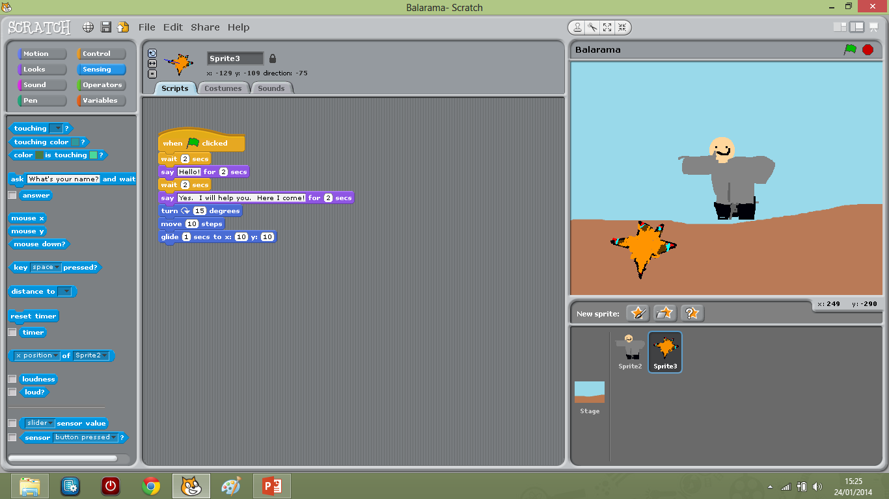
Adding Animation
Notes:
Characters (or Sprites) need to be animated within the story. A sample image only.

Slide 13
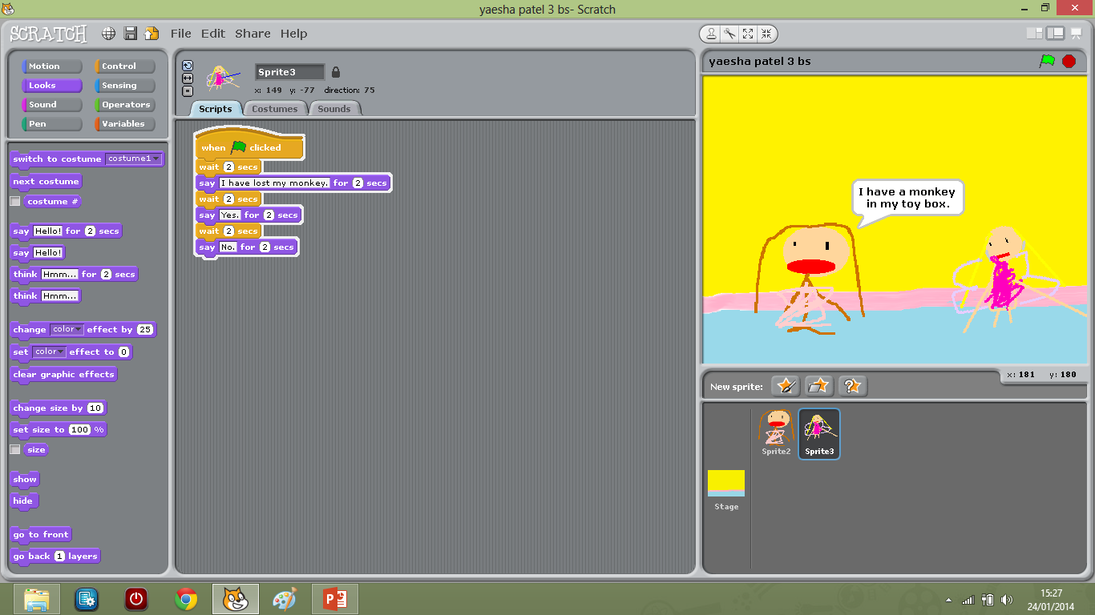
Adding dialogue Using the Looks coding blocks.

Slide 14
Skills developed in Y1 and Y2:
Literacy:
All pupils: Writing a short story in three scenes, and creating two characters (Sprites), with simple dialogue.
Some pupils: Adding voice-over sound files in English, Guajarati and Hindi.
Computing;
Logging on to the school computer network, using a password
Loading the Scratch program
Loading the Paint program
Using the Paint editor in Scratch to create the pupil’s own two different Sprites (or characters)
Using Paint to create three Backgrounds (or scenes)
Importing the Backgrounds into Scratch
Using the Control blocks to start the narrative
Using the Motion blocks to move the Sprites
Using the Looks blocks to add dialogue
Saving the work in appropriate areas of the school network
Logging off properly
Notes:
This is what all pupils will have achieved by the end of the project. We have still to do the “green skills” for the story. The pupils can do this, as a separate skill at present.

Slide 15
Teaching materials for Primary
and Secondary teachers
Interconnected
web sites
World Ecitizens
To show pupils’ creative work
MESH to provide pedagogy
and analysis of the project
Notes:
Three inter-related web sites.

